Slide 1
PC Maintenance: Preparing for A+ Certification
Chapter 7: Cables

Slide 2
Chapter 7 Objectives
Differentiate between serial and parallel data transmission
Know how to read a cable pin-out diagram
Identify common connector types and their purposes
Identify types of cables used for networking
Troubleshoot cable problems

Slide 3
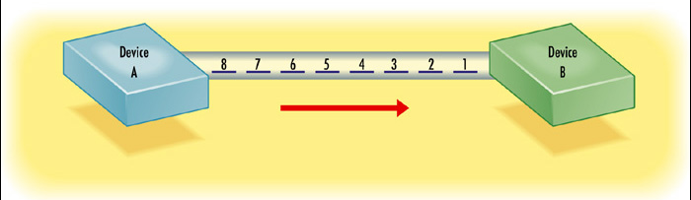
Serial Data Transmission
Only one wire carries data in each direction
Data travels one bit at a time

Slide 4
Serial Data Transmission
Examples:
  Legacy COM port (“serial port”)
  Universal Serial Bus (USB)
  FireWire (IEEE 1394)
  Serial IDE

Slide 5
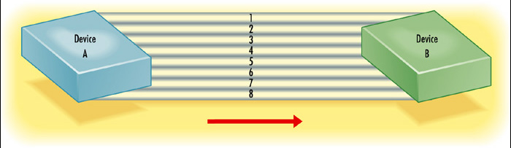
Parallel Data Transmission
Multiple (usually eight) wires carry data in each direction
Data travels one complete byte at a time

Slide 6
Parallel Data Transmission
Examples:
  Legacy LPT port (“parallel port,” “printer port”)
  IDE ribbon cable

Slide 7
Cable Construction
Connectors on each end
Conduit (wire, glass)
Protective casing around conduit
  Dirt and other contaminants
  Electromagnetic interference

Slide 8
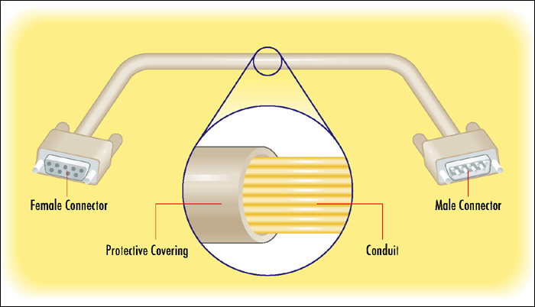
Cable Construction

Slide 9
Pin-Out Diagrams
Numbers each pin of each connector
States the purpose of each pin in data transmission

Slide 10
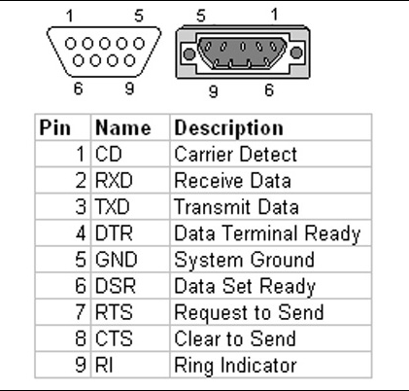
Pin-Out Diagram Example

Slide 11
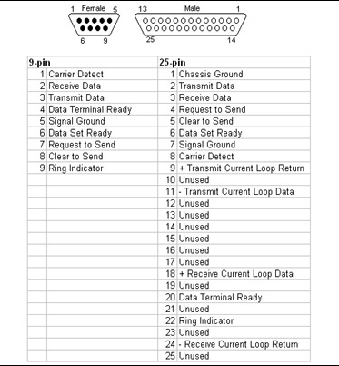
Pin-Out Diagram Example

Slide 12
Connector Types
BNC
D-Sub (DB)
Centronics
Ribbon
RJ
DIN
Mini-DIN
Audio
USB
FireWire/IEE-1394
Power
  Mini
  Molex

Slide 13
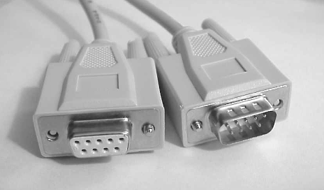
Legacy Serial
Also called COM Port
Nearly synonymous with “serial”
Male DB-9 or DB-25 on PC
Max. speed depends on UART chip

Slide 14
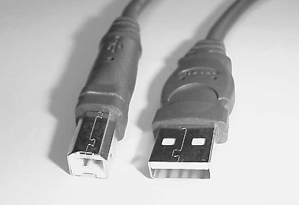
USB
Universal Serial Bus
Standards:
  USB 1.1, 12Mbps
  USB 2.0, 400Mbps
Fully Plug and Play
Fully hot-pluggable
Many devices can share a single set of resources (IRQ, address)

Slide 15
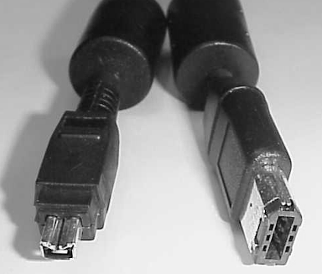
FireWire
IEEE 1394 is the specification
A competitor to USB
Not as widely adopted on motherboards
Preferred interface for digital video cameras
Max. speed of 100 to 200Mbps

Slide 16
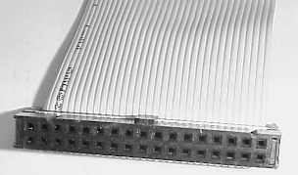
IDE Ribbon Cables
Support up to two drives per cable
Most motherboards support up to two cables
40-wire, normal
80-wire, enhanced version
  Uses only 40 wires for data
  Extra wires are buffers to reduce EMI

Slide 17
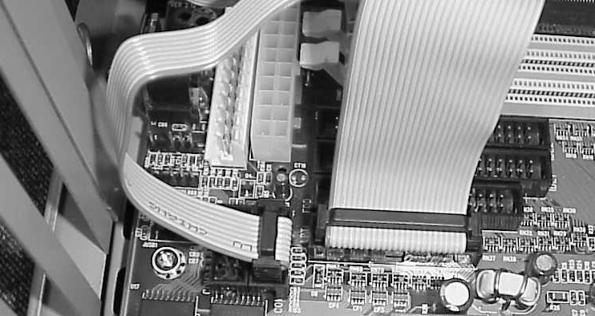
Other Common Ribbon Cables
Legacy parallel and serial port connections to an AT-style motherboard

Slide 18
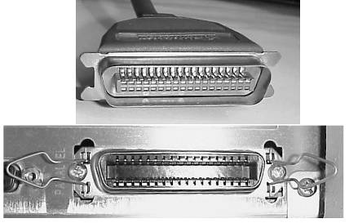
Parallel Printer Cables
25-pin at PC end
  Female on PC
  Male on cable
  Opposite of 25-pin legacy serial
36-pin Centronics at printer end

Slide 19
Legacy Parallel Port Modes
IEEE 1284 is the standard
SPP: Standard Parallel Port
  8-bit output at 150KB/sec
  4-bit input at 50KB/sec
Bidirectional
  Improved version of SPP
  8-bit input and output
  150KB/sec in both directions

Slide 20
Legacy Parallel Port Modes
Enhanced Parallel Port (EPP)
  Bidirectional 8-bit data transfer at 2MB/sec
  Designed for non-printer devices such as drives
Enhanced Capabilities Port (ECP)
  Same as EPP in speed and width
  Designed specifically for printers and scanners
  Uses a DMA channel

Slide 21
Network Cables
Coaxial
Twisted Pair
Fiber Optic

Slide 22
Coaxial Cable
Thick Ethernet
  0.5” in diameter
  10Base5 networking
Thin Ethernet
  0.2” in diameter
  10Base2 networking

Slide 23
Unshielded Twisted Pair
Categories:
  Cat1 – traditional telephone cable. Two pairs
  Cat2: Four pairs
  Cat3 – 10BaseT Ethernet, four pairs
  Cat5 – 100BaseT Ethernet, four pairs
  Cat5e – Gigabit Ethernet, four pairs

Slide 24
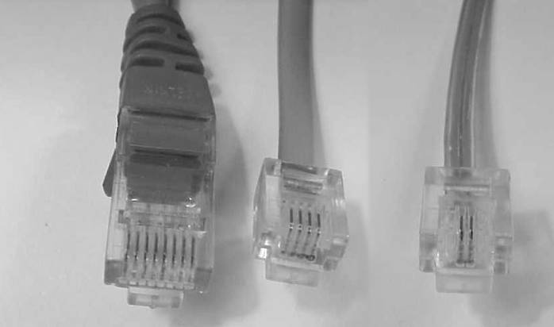
Connectors on UTP Cable
RJ-45, used for
networking
RJ-14, dual-line
phone systems
RJ-11, single-line
phone systems

Slide 25
Shielded Twisted Pair
EMI Shielding
Described with types, not categories
  Type 1: Two pairs. Most common type
  Type 2, Type 3: Four pairs
  Type 6: Patch cable for token ring hubs
  Type 8: Flat for running under carpets
  Type 9: Two pair, high-grade

Slide 26
Fiber Optic Cable
Uses light, not electricity
Expensive
Can be difficult to work with
High performance
Long range (up to 6500 feet)
Used with some FDDI and ATM networks

Slide 27
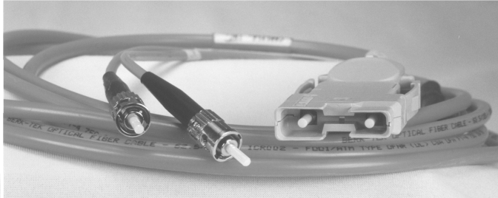
Fiber Optic Cable

Slide 28
Troubleshooting Cables
Check port status in BIOS Setup
Check port status in Windows
Test port with loop-back plug
Check cable for broken wires with multimeter

